Slide 2
REMEMBER WHO YOU ARE!

Slide 3
Five Things to Remember after Conversion!

Slide 4
Five Things God Wants You To Do After Conversion!
Sunday AM - July 3

Slide 5
#1. You are a new creature!

Slide 7
A New Creation!
A true conversion is a translation into something different (Col 1:13)!
Raised to walk in newness of life (Rm 6:4)!
We are “called out” (II Cor 6:17)!

Slide 8
A New Creation!
Must die to self in order to become a new creation (Gal 2:20)!
Our outward good behavior is only a fruit of the change within (I John 5:3).

Slide 9
A New Creation!
Christianity is not a way of looking at certain things, but a certain way of looking at all things!
Being on the church roll does not necessarily make a true Christian.

Slide 10
#2. You are to never stop Growing!

Slide 11
You are a Work in Progress!
Babes in Christ (I Peter 2:2, I Cor 3:1-2).
Constant growth is essential!

Slide 12
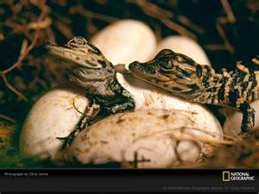
SHORT BABY ALLEGATORS

Slide 13
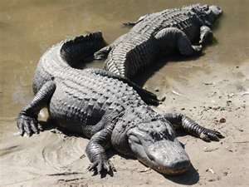
17 FEET TO 19 FEET LONG! Up to 1300 lbs
NEVER STOP GROWING!

Slide 14
You are a work in progress!
Babes in Christ (I Peter 2:2, I Cor 3:1-2)!
Satan will tempt us but with God you can overcome (I Cor 10:11-13)!

Slide 15
#3. There is a possibility of Falling!

Slide 16
Be on guard!
I Cor 10:12 “He that thinks he stands… take heed!
John 8:31 “If you continue in my word, you are my disciples!”
I Jn 2:1-2 “I write that you sin not..”
Simon the Sorcerer – Acts 8:17-24

Slide 17
#4. Representative of Jesus Christ

Slide 19
2 Cor 3:2-3
“You are our letter, written in our hearts, known and read by all men; being manifested that you are a letter of Christ, cared for by us, written not with ink but with the Spirit of the living God, not on tablets of stone but on tablets of human hearts.”

Slide 21
#5. Jesus Christ is our example!

Slide 22
Jesus Christ is our example
1 Peter 2:21-22 “For you have been called for this purpose, since Christ also suffered for you, leaving you an example for you to follow in His steps.”

Slide 23
Jesus Christ is our example
Heb 12:1-2 “Let us run with patience the race ... looking to Jesus, the author and finisher of our faith.”
Cure for pride is to always compare ourselves to sinless Jesus!

Slide 24
Christianity is . . .
Science of character building
Philosophy of immortality
Solution to the riddle of existence!

Slide 25
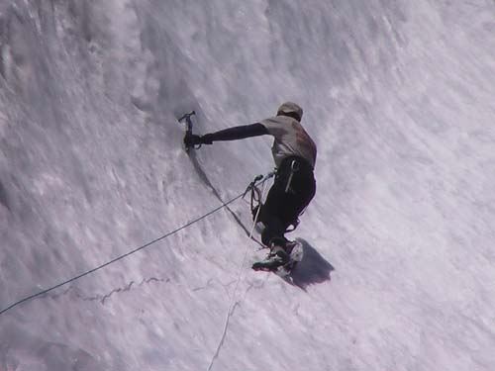
Ready to Become a Christian?
Be baptized
(Mark 16:16; Acts 2:38)
Have You
Obeyed
The
Gospel?
Confess your faith
(Romans 10:9-10)
Repent of your sins
(Acts 2:38; Acts 17:30)
Believe the gospel
(Mark 16:16)

