Slide 1
Angel Torress
June 2008

Slide 2
2 Indisputable Facts
Fact [1]
Countless people all around us are in grave danger.
Fact [2]
God commands us to do something about it.

Slide 3
SHINE
My daily life should be a living testimony to the better way Jesus offers.
4
Simple Things
We All Can Do
To Reach The Lost
WHAT CAN WE DO?

Slide 4
Phil 2:15-16
“In the midst of a crooked and perverse generation, among whom you appear as lights in the world, 16 holding fast the word of life..” NASU

Slide 5
Matt 5:14-16
14 "You are the light of the world. A city set on a hill cannot be hidden;
16 "Let your light so shine before men in such a way that they may see your good works, and glorify your Father who is in heaven. NASU

Slide 6
SHINE
SPEAK
My daily life should be a living testimony to the better way Jesus offers.
Spiritual things
should naturally come out in my conversation with others.
4
Simple Things
We All Can Do
To Reach The Lost

Slide 7
Matt 10:22-23
32 "Therefore everyone who confesses Me before men, I will also confess him before My Father who is in heaven. 33 "But whoever denies Me before men, I will also deny him before My Father who is in heaven. NASU

Slide 8
WHAT SHOULD I SAY?
Talk about God’s word.
Give God glory for good things in our lives.
Tell the lost we are praying for them.
Point grieving people to God.
Speak positively about the congregation.
Say simple things.

Slide 9
SHINE
SPEAK
My daily life should be a living testimony to the better way Jesus offers.
Spiritual things
should naturally come out in my conversation with others.
4
Simple Things
We All Can Do
To Reach The Lost
INVITE
As we talk
positively about spiritual things, we should invite others to check it out for themselves.

Slide 10
INVITE PEOPLE TO...
Men’s devotional
Teen/Ladies/Young adult weekend
Annual singing!
Specific Sermon Topics
VBS children up to adult
Invitation Events??
25%
of those who do not attend church services would come if invited

Slide 11
Invitation Events
Sunday’s Coming – Resurrection
Authentic Love – I Cor 13
Could the NT documents have been forged?
Jesus/Peter & the Rock
25%
of those who do not attend church services would come if invited

Slide 12
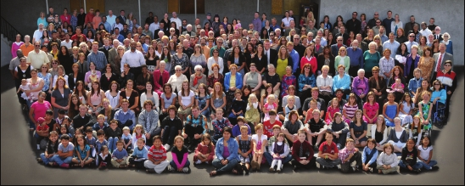
“Where Families Build Eternal Homes”

Slide 13
The Johnson Ave Church meets at 523 S. Johnson Ave, El Cajon, CA 92020
Regular Assemblies
NORTH
HWY67
Sunday:
9:00 a.m. Elective Bible Classes for all
10:00 a.m. Praise-Prayer-Preaching
6:00 p.m. Worship-Edification Service
Wednesday:
7:00 p.m. Elective Bible Classes
JOHNSONAVENUE
INTERSTATE 8
MAIN STREET
MAGNOLIA
Spanish services
Call Oscar: 619-227-3730
www.jacofc.org
THIS IS YOUR SPECIAL INVITATION TO BE MY GUEST
Brent Hunter
Jan 22
From:
Date:
Rx for the B.E.S.T. marriage
Event/Topic:
Visit our website at www.jacofc.org

Slide 14
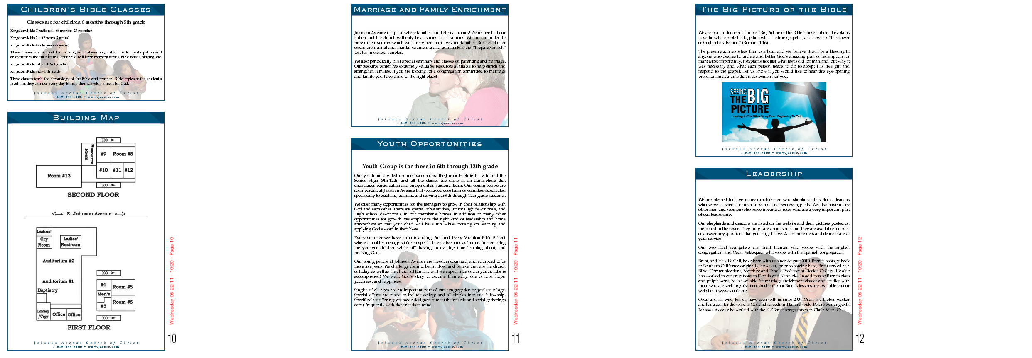
First Principle DVD
Visitors packet
Cost is only $1.00

Slide 15
SHINE
SPEAK
My daily life should be a living testimony to the better way Jesus offers.
Spiritual things
should naturally come out in my conversation with others.
4
Simple Things
We All Can Do
To Reach The Lost
INVITE
WELCOME
As we talk
positively about spiritual things, we should invite others to check it out for themselves.
We must
make sure that those who come to check us out are warmly welcomed.

Slide 16
TO WELCOME GUESTS...
Introduce yourself.
Find out why they have come.
Extend every courtesy.
Adhere to the “10-Minute” Rule.

Slide 17
Go therefore
and make disciples
of all the nations
ENERGIZING EVANGELISM

Slide 18
SHINE
SPEAK
My daily life should be a living testimony to the better way Jesus offers.
Spiritual things
should naturally come out in my conversation with others.
4
Simple Things
We All Can Do
To Reach The Lost
INVITE
WELCOME
As we talk
positively about spiritual things, we should invite others to check it out for themselves.
We must
make sure that those who come to check us out are warmly welcomed.

