Slide 1
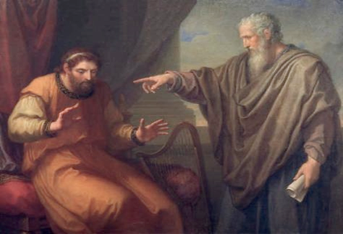
The Nathan Principle
How To Convict the Sincerely Deceived of Religious Error

Slide 2

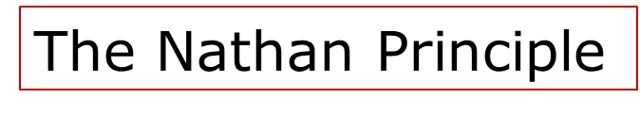
The Nathan Principle
II Samuel 12
THE KEY:
  Help the one being taught to make an objective decision before he/she becomes emotionally involved!!

Slide 3

Three things have nothing to do with Truth . . . . (Jn 8:32)
The Amount of Time . . .
The Number of People . . .
The Degree of Sincerity of the believers.
The Nathan Principle

Slide 4
Noah was saved by . . .
Grace --Gen 6:8
Faith -- Heb 11:7
Obedience – Gen 6:22 “All that Jehovah asked him to do, so did he.”
Faith, Grace, Obedience … are not mutually exclusive

Slide 5
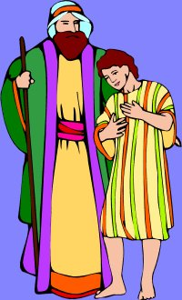
Jacob and Joseph
Gen 37:31-35 And they took Joseph's coat, and killed a kid of the goats, and dipped the coat in the blood; 32 And they sent the coat of many colors, and they brought it to their father; and said, This have we found: know now whether it be thy son's coat or not?
33 And he knew it, and said, “It is my son's coat; an evil beast hath devoured him; Joseph is without doubt rent in pieces.”

Slide 6

Jacob and Joseph
34 And Jacob rent his clothes, and put sackcloth upon his loins, and mourned for his son many days.
35 And all his sons and all his daughters rose up to comfort him; but he refused to be comforted; and he said, For I will go down into the grave unto my son mourning. Thus his father wept for him.
The Nathan Principle

Slide 7

Jacob and Joseph
Notice: Jacob hears a lie (deceived) and believes it!
Results in an extreme emotional response!
22 years pass . . .

Slide 8
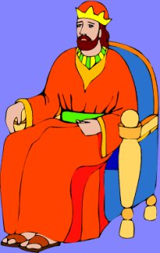
Joseph is alive and a ruler in Egypt!
Gen 45:25-28 Then they went up from Egypt, and came to the land of Canaan to their father Jacob. 26 They told him, saying, "Joseph is still alive, and indeed he is ruler over all the land of Egypt." But he was stunned, (his heart fainted KJV) for he did not believe them.”

Slide 9

Jacob and Joseph
Now there is good news –the truth – and yet no emotional response!

Slide 10
Conclusion:
Our emotional response to a message has nothing to do with whether or not the message we heard was true or false!
However, once Jacob saw the evidence he lined up his feelings with the facts!

Slide 11

Notice:
On to Egypt!
27 When they told him all the words of Joseph that he had spoken to them, and when he saw the wagons that Joseph had sent to carry him, the spirit of their father Jacob revived.
28 Then Israel said, "It is enough; my son Joseph is still alive! I will go and see him before I die."

Slide 12
Future application:
“I know I’m saved because …
  Prayed through . . .
  “Burning in my bosom”
  Feeling better felt than told!
Jacob thought he knew for sure Joseph was dead too!
The Nathan Principle

Slide 13
Future application:
I don’t doubt.. emotional experience, but does that experience prove you were right?

Slide 14
Moses and the Red Sea . . .
Exodus 14: 13 “ And Moses said unto the people, Fear ye not, stand still, and see the salvation of the Lord, which he will show to you today ..
Exodus 14:29 “The children of Israel walked upon dry land in the midst of the sea; and the waters were a wall unto them on their right hand, and on their left.”

Slide 15
I Corinthians 10:1-4
Elements of Baptism: “The sea and the cloud.”
Cloud
Red Sea
Red Sea

Slide 16
The Baptism of the Sea and the Cloud
Ex. 14:30 “Thus the Lord saved Israel that day out of the hand of the Egyptians; and Israel saw the Egyptians dead upon the sea shore.
vs 31 “And Israel saw that great work which the Lord did upon the Egyptians; and the people feared the Lord.”

Slide 17
$64,000 Question . . .
Were they saved before they went into the “baptism of the sea and the cloud” (crossed the Red Sea) or afterwards?
Are we saved before we are baptized or afterwards?

Slide 18

This is the key!
Keep your discussions as objective as possible.
Use the Nathan principle and overcome one of the greatest barriers to personal teaching!
The Nathan Principle

