Slide 1
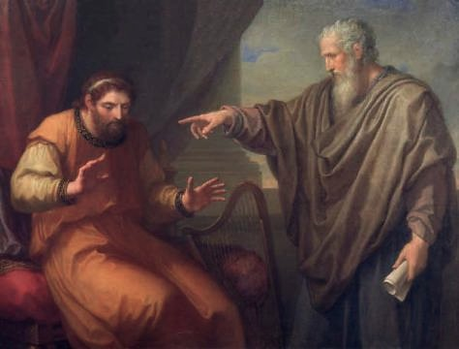
The Nathan Principle
How To Convict the Sincerely Deceived of Religious Error

Slide 2
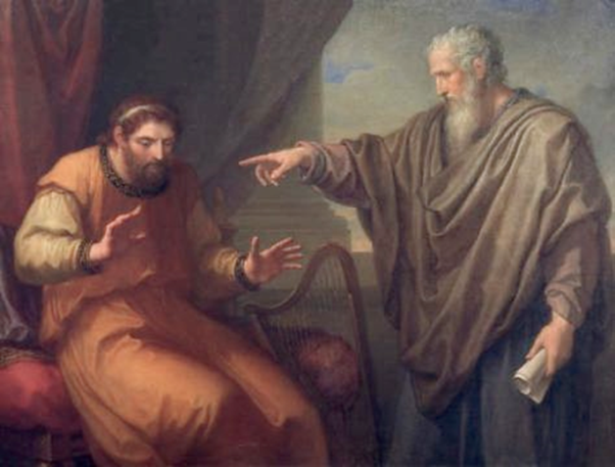
The Nathan Principle
II Samuel 12
THE KEY:
  Get the prospect to make an objective decision before they become emotionally involved!!

Slide 3
The Nathan Principle
_____
How long is this line?
One guess/opinion is as good as another.
Measure it with a ruler, and all the guesses/opinions that don’t measure up are wrong. Right?

Slide 4
The Nathan Principle
Is that being narrow or too closed minded?
  What if after the truth was pointed out one still refuses to admit they were mistaken?
  Either ignorant, or just being stubborn!

Slide 5

THE BIBLE IS OUR RULE
God gave the Israelites ten commandments not ten suggestions.
Religion is based upon authority (Col 3:17)!
Let’s agree never to say, “I think so,” “I was always taught,” “My church teaches.”
  Instead: Paul said, or Jesus teaches, Peter wrote, rather than “I think” or the “church of Christ teaches.”
  I Thess 1:8 The church “sounded out the word of the Lord.”

Slide 6
Application:
Mark 16:16 “He that believeth and is baptized shall be saved, he that believed not shall be condemned.”
Is that being narrow or too closed minded?
  What if after the truth is pointed out and one still refuses to admit they were mistaken?
  Either ignorant, or just being stubborn!

Slide 7
Three things have nothing to do with Truth (Jn 8:32)!
The Amount of Time . . .

Slide 8


Three things have nothing to do with Truth (Jn 8:32)
The Number of People . . .

Slide 9
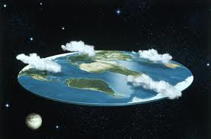
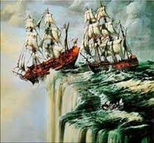
Three things have nothing to do with Truth (Jn 8:32)
The Degree of Sincerity of the believers . .

Slide 10
What’s the difference?
Between Baptist, Methodists, and Catholics and those of us who are undenominational?
  We all believe in God . . .
  We disagree on how we come to terms with that God . . .

Slide 11
What’s the difference?
Denominational people say: “Go to the church of your choice, come to terms with God on my terms.”
Undenominational perspective: “Go to the church of His choice, come to terms with God on His terms, not mine.”

Slide 12

Ecc. 5:1
“To draw nigh to hear (listen) is better than to give the sacrifice of a fool, not knowing they are doing evil.”
If you are going to be religious, make sure you do it so that it gets you to heaven!
Undenominational = Not divide, but unite on God’s truth.

Slide 13

Do not say:
Church of Christ people
C of C preachers/doctrine
Let us hear what the Church of Christ teaches!
I’m trying to convert him to the Church of Christ
The Church of Christ teaches
The Church of Christ is right.

Slide 14

Review:
How long is this line? Col 3:17
Three things that have nothing to do with truth. Jn 8:32
What is the difference between denominations and those who strive to be undenominational?
Ecc 5:1.

Slide 15

The Nathan principle
Look for key principles first, then subsequent teaching becomes easier
Keep discussions as objective as possible.
Use the Nathan principles to overcome one of the greatest barriers to personal teaching.

Slide 16
The Nathan Principles 1-3
How To Convict the Sincerely Deceived of Religious Error

