Slide 1
23 Things that
SAVE

Slide 2
23 Things that
SAVE
Ultimate question: What must I do to be saved?
THESIS:
  A figure of speech.
  Helpful all inclusive list (Ps 119:160).

Slide 3
Synecdoche
Def: “A figure of speech in which a term or part of something is used to refer to the whole of something.”
  Ex. “Head” for the entire cow.
  Ex. “Sail” for the entire sailboat.
  Ex. “Wheels” = the entire vehicle
  Ex. The way Jesus used “cup.”

Slide 4
Synecdoche
John 3:16 “Whosoever believeth on Him shall not perish.”
  Will everyone who gives “mental ascent only” be saved?
  “Believe” is often used as a synecdoche.
I Peter 3:21 “Baptism now saves you.”
  Will everyone who is “baptized only” be saved without belief?

Slide 5
Synecdoche
Rom 10:9:
  “If you confess with your mouth Jesus as Lord, and believe in your heart that God raised Him from the dead, you will be saved.”
  Belief and confession refer to the whole.
What about “Faith only?”
  James 2:24: “You see that a man is justified by works and not by faith alone.”

Slide 6
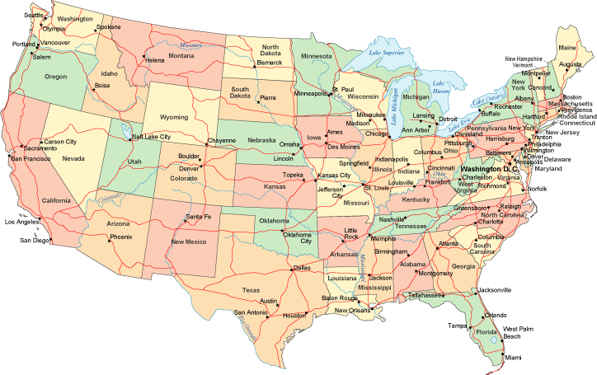
How Far to Birmingham?
Seattle - 2540 miles
Denver - 1330 miles
Memphis - 260 miles
How Far to Birmingham?
How Far to Birmingham?
The answer to the question depends on where the person is when they ask the question!

Slide 7

What Must I Do to be Saved?
Macedonian Jailor (unbeliever)
Pentecost (believed and confessed)
Paul (believed, confessed,and repented)
“believe” (Acts 16)
“repent and be baptized” (Acts 2)
“be baptized and wash away your sins” (Acts 22)
Notes:
Ac 16:27 When the jailer awoke and saw the prison doors opened, he drew his sword and was about to kill himself, supposing that the prisoners had escaped.
28 But Paul cried out with a loud voice, saying, "Do not harm yourself, for we are all here!"
29 And he called for lights and rushed in, and trembling with fear he fell down before Paul and Silas,
30 and after he brought them out, he said, "Sirs, what must I do to be saved?"
31 They said, "Believe in the Lord Jesus, and you will be saved, you and your household."
32 And they spoke the word of the Lord to him together with all who were in his house.
33 And he took them that very hour of the night and washed their wounds, and immediately he was baptized, he and all his household.
34 And he brought them into his house and set food before them, and rejoiced greatly, having believed in God with his whole household.

Slide 8
14 Things that have some part in the Salvation from Sin
The Father – Titus 3:4-5, Eph 3:8-9.
The Son – Jn 3:16, I Tim 1:15, Lk 19:10.
The Holy Spirit – I Cor 6:11, Jn 16: 7-13.
God’s grace – Eph 2:8-9, Titus 2:11-12.
God’s love – Jn 3:16, I John 4:17.
Hope – Rom 8:24.
Life of Christ – Rm 5:10.

Slide 9
14 Things that have some part in the Salvation from Sin
The cross (Christ’s sacrifice) – I Cor 1:18.
The Blood of Christ (Shed on the cross) – Rom 5:8-9.
The Name of Christ (His authority)- Acts 4:12.
The Gospel – Rm 1:16, I Cor 15:1-2.

Slide 10
14 Things that have some part in the Salvation from Sin
Preachers/messengers – I Cor 1:21.
Truth – John 8:32, 2 Thess 2:10.

Slide 11
9 Ways We Must Respond.
HEAR – Rom 10:14-17, Acts 11:14
BELIEVE (FAITH) – Jn 8:24, Heb 11: 6
REPENTANCE (Turn) – Acts 2:38, 3:19, Acts 17:30
CONFESSION – Matt 10:32-33, Rm 10:9-10, Acts 8: 36-37.
BAPTISM – Mk 16:16, Acts 2:38

Slide 12
Preaching Jesus
Acts 8:35-39
Then Philip opened his mouth, and beginning from this Scripture he preached Jesus to him.
As they went along the road they came to some water; and the eunuch said, "Look! Water! What prevents me from being baptized?"
And Philip said, "If you believe with all your heart, you may." And he answered and said, "I believe that Jesus Christ is the Son of God."
And he ordered the chariot to stop; and they both went down into the water, Philip as well as the eunuch, and he baptized him.
When they came up out of the water, the Spirit of the Lord snatched Philip away; and the eunuch no longer saw him, but went on his way rejoicing.
preached Jesus
baptized
rejoicing

Slide 13

Born Again
John 3:5
Jesus answered, Truly, truly, I say to you, unless one is born of water and the Spirit he cannot enter into the kingdom of God.
Used by the early church writers as baptismal proof text!

Slide 14
2nd Century Teaching and Practice
Irenaeus (150 ad)
“As we are lepers in sin, we are made clean from our transgressions by means of the sacred water and the invitation of the Lord. We are thus spiritually regenerated as newborn infants, even as the Lord declared,
‘except a man be born again…’” (John 3:3)
Irenaeus, "Fragments From Lost Writings", no. 34,
Ante-Nicene Fathers, vol. 1, pg. 574

Slide 15
Born of Water and the Spirit
(Titus 3:5)
5 He saved us, not on the basis of deeds which we have done in righteousness, but according to His mercy, by the washing of regeneration and renewing by the Holy Spirit,
(John 3:5)
5 Jesus answered, "Truly, truly, I say to you, unless one is born of water and the Spirit he cannot enter into the kingdom of God.
He saved us,
by the washing of regeneration and renewing
by the Holy Spirit,
born of water and the Spirit

Slide 16
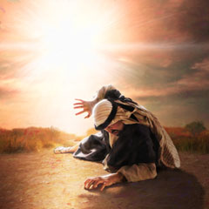
Saving Paul – Already a God fearing man
Believed -
“What shall I do,...”
Confessed -
“What shall I do, Lord?”
Obeyed –
“Get up and go into Damascus”
Fasted –
“three days… and neither ate nor drank”
Prayed –
“for he is praying”
Repentance
PLUS…
Healed–
Miraculous healing of his blindness
Notes:
Baptism is not the gospel – it is part of the gospel because it is the rsponse to the gospel
Man began to treat baptism as gospel – I came to preach gospel not to baptize

Slide 17

Saving Paul –
Repented for 3 Days
After all of these acts of repentance and miraculous healing
Paul was commanded:
Now why do you delay? Get up and
be baptized, and wash away your sins, calling on His name.'
be baptized, and wash away your sins,
Notes:
Baptism is not the gospel – it is part of the gospel because it is the rsponse to the gospel
Man began to treat baptism as gospel – I came to preach gospel not to baptize

Slide 18
4 Additional Ways We Must Respond (5 + 4 = 9).
Works – James 2:20-26, I John 3:24.
Obedience – Rm 1:5, Heb 5:8-9.
Endurance (Faithfulness) – Matt 10:22.
Save ourselves Acts 2: 40-41!

Slide 19
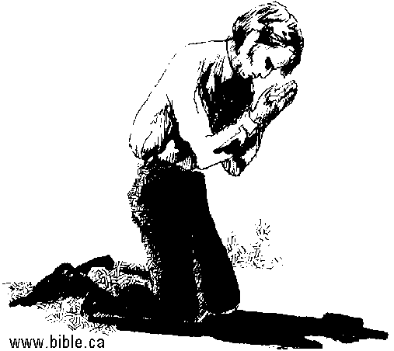
WHICH ONE OF THESE 23 THINGS WOULD YOU LEAVE OUT?
“The Word that I speak shall judge you in the last day” (Jn 12:48).
Where is the sinner’s prayer or asking God to come into your heart?
  Go to The Interactive Bible: www.bible.ca

Slide 20
WHICH ONE OF THESE 23 THINGS WOULD YOU LEAVE OUT?
Acts 20:27 “I shrank not to declare unto you the whole counsel of God.”

