Slide 1
Risk-takers, Care-takers, & Under-takers
For the future

Slide 2
FAMOUS BIBLE RISK-TAKERS
JESUS & MOSES
PETER, ANDREW, JAMES, AND JOHN
APOSTLE PAUL

Slide 3
VOCABULARY DIFFERS
Care-takers = “We’ve never done it that way before.”
Undertakers = “Good idea, BUT . . .”

Slide 4
VOCABULARY DIFFERS
Visionaries – “This is the right thing to do so we will find a way.”
“What would Jesus do?

Slide 5
What makes the difference?
A Grateful appreciation of what has been.
A Realistic Dream of what could be.
For the future

Slide 6
4
KEYS

Slide 7
FOUR KEYS TO VISIONARY THINKING

Slide 8
FELLOWSHIP VS. ISOLATION
T.E.A.M =
TOGETHER
EVERYONE
ACCOMPLISHES
MORE!

Slide 9
FELLOWSHIP VS. ISOLATION
WE ALL ARE SERVANTS!
(Matt 20:25-28)
JESUS MODELED HUMBLE SERVANT LEADERSHIP
Triumphal Entry (Matt 21)

Slide 10
FELLOWSHIP VS. ISOLATION
JESUS: “By this the world may know that you are my disciples, by the love you show for each other” (Jn 13:34-35).

Slide 11
MISSION VS. MAINTENANCE
Jesus: “The kingdom of God is within you” (Lk 17:20)!
The fruit of the spirit = realities of kingdom rule (Gal 5: 22-25)!
Pray: “Thy kingdom come…”

Slide 12
INVOLVEMENT VS. INACTIVITY
God appointed leaders to “equip the saints for the work of ministry” (Eph 4:11).
God expects “every joint to fill its several part” (Eph 4:16).
The church = “the called out body.”

Slide 13
PYRAMID OF POWER?
Elders
Deacons
Members..

Slide 14
CIRCLE OF CARING FELLOWSHIP
Family Members
Deacons
New converts
Encouragers
Shepherds
Teachers

Slide 15
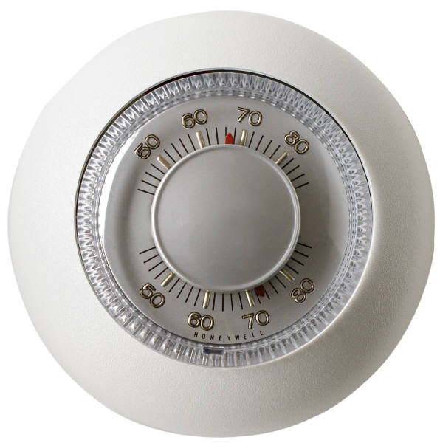
THERMOSTATS VS. THERMOMETERS

Slide 16
Jesus: NO PLACE FOR NEUTRALITY!
“He that is not with me is against me, he that gathers not with me, scatters abroad.” (Matt 12:30)

Slide 17
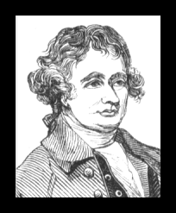
THERMOSTATS VS. THERMOMETERS
“There is only one thing necessary for evil to triumph and that is for good men and women to stand by and do nothing.”
Edmond Burke

Slide 18
TWO CHOICES:
LIGHT
DARKNESS

Slide 19
FOUR KEYS TO VISIONARY THINKING

Slide 20
Dreaming the Dream
Seeing the Vision

