Slide 1
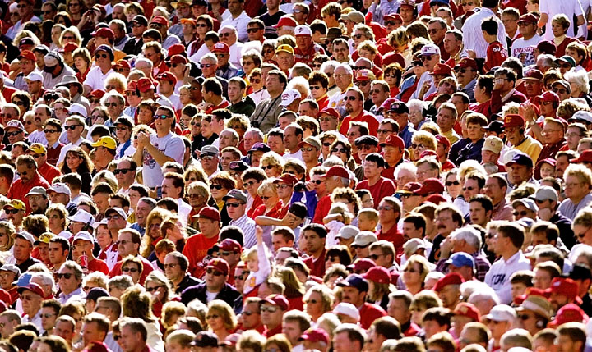
Preach THE GOSPEL
The gospel is a MESSAGE that is to be PREACHED to every person
Notes:
The gospel is a message to be preached
Notice that this is a command of Christ to His followers - that means you and me. Does it matter how often we come to services or how pure we try to adhere to doctrinal matters if we don’t follow this command of Christ.
The gospel is important
<TR>Why is the gospel so important?

Slide 2
THE GREATEST NEED
For every Christian to understand they are to be personally involved somehow, someway in the mission of Jesus.
Notes:
The gospel is a message to be preached
Notice that this is a command of Christ to His followers - that means you and me. Does it matter how often we come to services or how pure we try to adhere to doctrinal matters if we don’t follow this command of Christ.
The gospel is important
<TR>Why is the gospel so important?

Slide 3
2 Indisputable Facts
Fact [1]
Countless people all around us are in grave danger.
Fact [2]
God commands us to do be apart of His mission and to do something about it!

Slide 4
REASONS WHY
A Direct Command (Matt 28:18-20) to every generation!
Not optional but similar to LS, assembling, etc.
Not a “gift” some have and some don’t. (ICor 12:12-26)
Heb 5:12 “There comes a time when . . “
Disciples were scattered and went everywhere teaching. (Acts 8:4)
Acts 4:20 “We cannot help but speak!”

Slide 5
REASONS WHY
All disciples –(Both male and female!)
Priscilla and Aquila (Acts 18:26)
All priests! I Peter 2:9
But you are A CHOSEN RACE, A royal PRIESTHOOD, A HOLY NATION, A PEOPLE FOR God's OWN POSSESSION, so that you may proclaim the excellencies of Him who has called you out of darkness into His marvelous light.

Slide 6
QUESTION
Is our model to be like ancient Israel (OT) or to be like the church in the book of Acts (NT)?

Slide 7
REASONS WHY
Necessary for Self preservation (Jn 15:6)
2 "Every branch in Me that does not bear fruit, He takes away; and every branch that bears fruit, He prunes it so that it may bear more fruit.. 6 "If anyone does not abide in Me, he is thrown away as a branch and dries up; and they gather them, and cast them into the fire and they are burned.
Others blood can be put on our heads!
Acts 18:6 But when they resisted and blasphemed, he shook out his garments and said to them, "Your blood be on your own heads! I am clean. From now on I will go to the Gentiles
Acts 20: 26 "Therefore, I testify to you this day that I am innocent of the blood of all men. 27 "For I did not shrink from declaring to you the whole purpose of God.

Slide 8
KEY
CALLED TO FAITHFULNESS, NOT RESULTS! Rm 5:1, I Cor 3:6
Think of Noah!

Slide 9
REASONS WHY
Because of our love for others! (Jas 5:20)
20 let him know that he who turns a sinner from the error of his way will save his soul from death and will cover a multitude of sins.
What is the greatest gift you could give?
Would you share an antidote to a terminal illness?

Slide 10
REASONS WHY
We need to be like the early church
Primary purposes: “Gather the saved, and scatter the Word.”
Early church was fiercely evangelistic!
Because of the value of a soul.
Never consider the lost until we stop and count the cost.
Soul is most valuable! (Ma 16:26)

Slide 11
REASONS WHY
Because of the (Fear) Terror of the Lord!
2 Cor 5:11 Therefore, knowing the fear (terro) of the Lord, we persuade men.
Whose terror? (Heb 10:31)
Do we believe all of Mk 16:16?
Because we are a Debtor.
Rm 1:14-16
14 I am under obligation (debt) both to Greeks and to barbarians, both to the wise and to the foolish. 15 So, for my part, I am eager to preach the gospel to you also who are in Rome. 16 For I am not ashamed of the gospel, for it is the power of God for salvation to everyone who believes.

Slide 12
REASONS WHY
Because of JOY!
Joy in heaven .. (Lk 15:7)
Personal Joy (Phil 4:1, III Jn 4)
You live through others and shine as the stars!
Dan 12:2-4 “Those who have insight will shine brightly like the brightness of the expanse of heaven, and those who lead the many to righteousness, like the stars forever and ever.

Slide 13
Conclusion
We need more vision!
God’s plan is “the glory of the ordinary.”
He knows He can use us, do you?
IF IT IS TO BE, IT IS UP TO ME!

Slide 14
Go therefore
and make disciples
of all the nations
ENERGIZE EVANGELISM

Slide 15
Conclusion
IF IT IS TO BE, IT IS UP TO ME!

