Slide 1
TO THE TVC CHURCH
OUR GOAL IS SOULS.

Slide 2
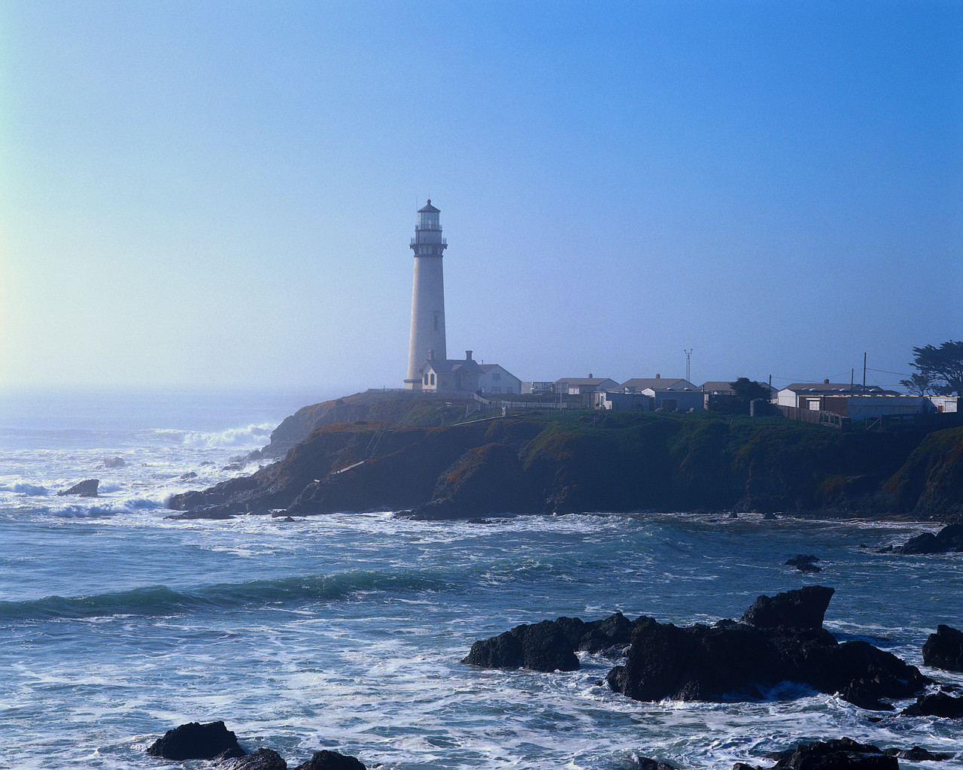
The Parable of the
Lighthouse

Slide 3
THE GREATEST NEED
IN THE CHURCH
GET BACK TO OUR MISSION

Slide 4
SAVING SOULS!

Slide 5
Thesis:
Why are so many not fulfilling it?
How it is to be fulfilled.
The need for personal involvement
The Greatest Need

Slide 6

Why are so many not fulfilling it?
TASK ORIENTATION
We get so involved in our tasks
that we fail to see the REASON behind the tasks.

Slide 7
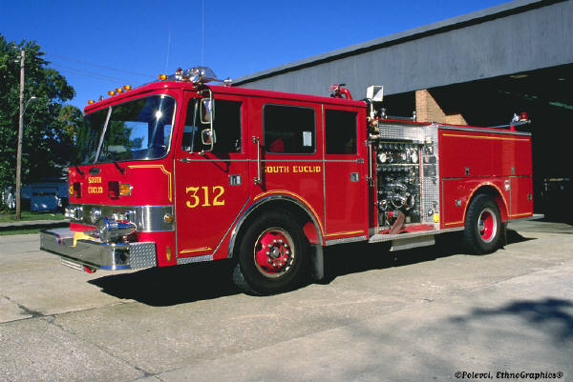


The game of FIRE HOUSE
Driver
Hook up hose
Hold the hose
THE JOB IS . . PUT OUT FIRES!

Slide 8
Why are so many not fulfilling it?
The Lord’s church must not be so task oriented that we forget to be SOUL oriented.

Slide 9
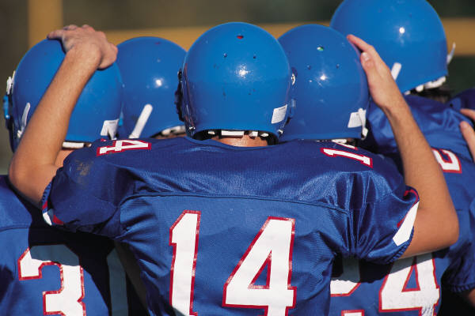
Why are so many not fulfilling it?
TOO MUCH TIME IN THE HUDDLE

Slide 10
We are the Body of Christ
Eph 1:22-23
“He is the HEAD but you
are His HANDS and FEET.”

Slide 13
WE MUST HAVE MORE GENUINE CONCERN FOR THE LOST!
JUDE 22, MATT 7:12

Slide 14
Why are so many not fulfilling it?
SOMETIMES INSTEAD OF AN OUT REACH WE HAVE AN IN-DRAG.

Slide 15
How is the need to be fulfilled?
THROUGH THE LORD’S MASTER PLAN OF EVANGELISM

Slide 16
The Lord’s Master Plan
II Tim 2:2
The GREAT COMMISSION was fulfilled in only 29 years! (Col 1:23)
HOW? X not +
The Greatest Need

Slide 17
The Lord’s Master Plan
II Tim 2:2
TEACHING IS THE 2nd HALF OF CHRISTIANITY.
EVANGELISM IS NOT COMPLETE UNTIL THE EVANGELIZED BECOME THE EVANGELIST!
The Greatest Need

Slide 20
IS PLENTEOUS
BUT THE LABORERS
ARE FEW

Slide 21
TO THE TVC CHURCH
OUR GOAL IS SOULS.

